Slide 1
Unit 1a ecosystem
FEC-7 INTRODUCTION TO ENVIRONMENTAL SCIENCE
DELHI TECHNOLOGICAL UNIVERSITY

Slide 2
Concept of ecosystem
An ecosystem is a community of organisms interacting with each other and non-living components for sustainable development and adaptation to changing conditions. there are different ecosystems around us that involve living and non-living organisms.
If we combine all the ecosystems present on Earth, it is called a biosphere.
The term ecosystem was first proposed by A.G Tansley (1935).
In an ecosystem, the interaction of life with its environment takes place at many levels so, in an ecosystem both organisms (biotic communities) and abiotic environment (rainfall, temperature, humidity) each influence the properties other for the maintenance of life.

Slide 3


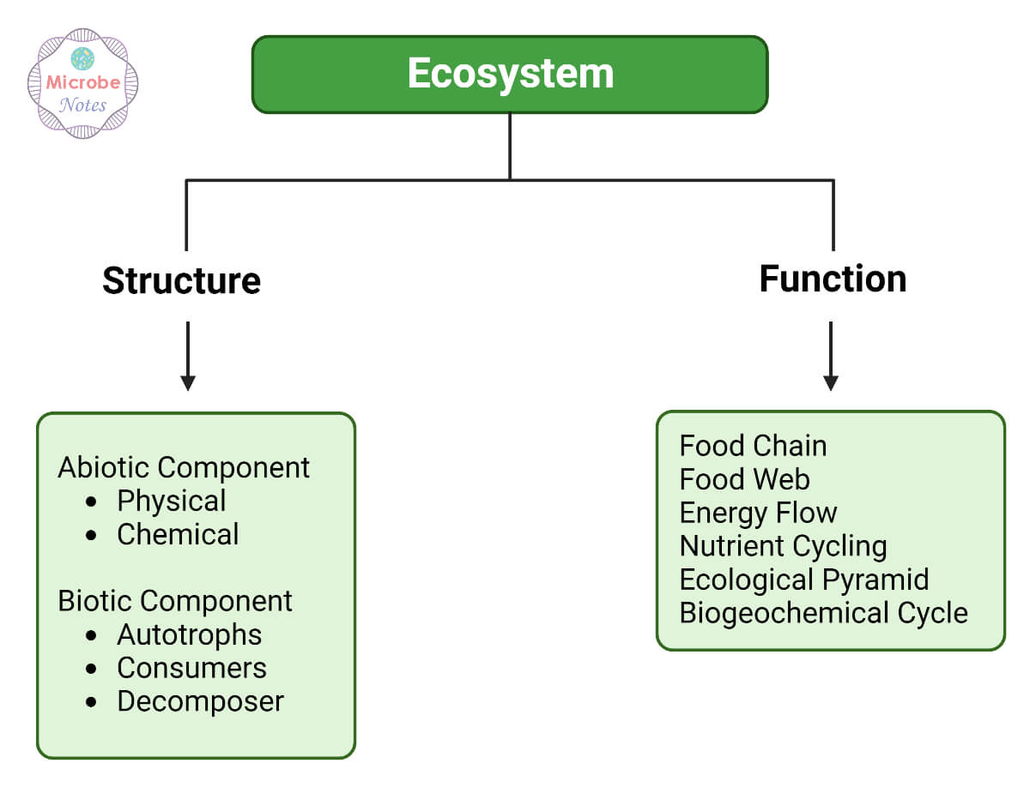
STRUCTURE OF ECOSYSTEM
A structure of the ecosystem comprised of the composition of the biological community including, species number, biomass, life history, and distribution in space.
The quantity and distribution of non-living material, such as nutrient water, etc.
The rage of conditions of existence such as temperature, and light.

Slide 4
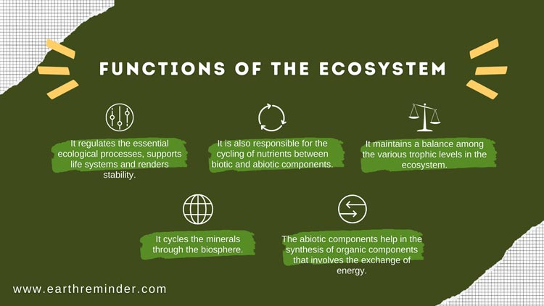
FUNCTIONS OF ECOSYSTEM
The rate of biological energy flow i.e. production & and respiration rates of the community.
The rate of material or nutrient cycles
Biological or ecological regulation including both regulation of organisms by environment and
Regulation of the environment by the organisms.

Slide 5
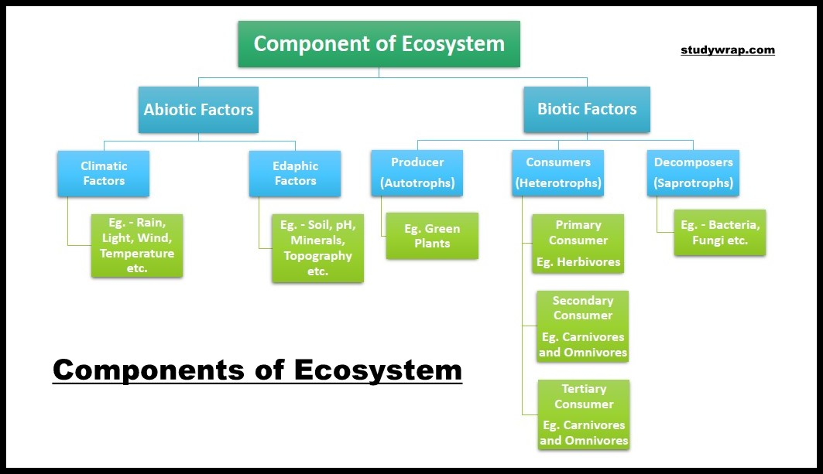
COMPONENTS OF ECOSYSTEM

Slide 6
Producer (autotrophs): The green plants have chlorophyll with the help of which they trap solar energy and change it into chemical energy of carbohydrates using simple inorganic compounds namely, water and carbon dioxide. this process is known as photosynthesis.
Photoautotrophs: an organism capable of synthesizing its own food from inorganic substances using light as an energy source. green plants and photosynthetic bacteria are photoautotrophs.
Chemotrophs: organisms that obtain energy by the oxidation of electron donors in their environments.
These molecules can be organic (chemoorganotrophs) or inorganic (chemolithotrophs).
Consumers (heterotrophs): The animals lack chlorophyll and are unable to synthesize their own food therefore they depend on the producers for their food.
They are known as heterotrophs (i.e. heteros= others, trophs= feeder).The consumers are of 4 types:

Slide 7
(a) Primary consumer: ( herbivores) i.e., animal feeding on plants, e.g., rabbit, deer, goat, etc.
(b) Secondary consumers: The animals feeding on herbivores are called secondary consumers or primary carnivores. e.g., cats, foxes, snakes.
(c) Tertiary consumers: These are large carnivores that feed on secondary consumers. e.g., wolves
(d) Quaternary consumers: They are also called omnivores; these are the largest carnivores that feed on tertiary consumers and are not eaten up by any other animals. e.g., lion and tiger.
Decomposers or Detrivores: Bacteria & fungi belong to this category.
They break down the dead organic matter of producers & and consumers for their food and release to the environment the simple inorganic and organic substance. these simple substances are reused by the producers resulting in a cyclic exchange of material between biotic & and abiotic environments. eg: bacteria, earthworms, beetles, etc.

Slide 8
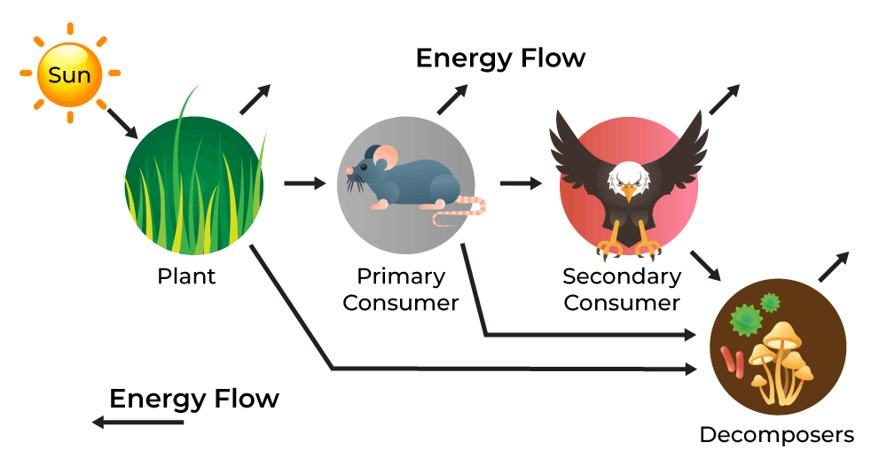
ENERGY FLOW IN THE ECOSYSTEM
The flow of energy is governed by laws of thermodynamics which state that:
(a) Energy can neither be created nor be destroyed but may be transformed from one form to another
(b) During the energy transfer there is degradation of energy from a concentrated form (mechanical, chemical, or electrical, etc.) to a dispersed form (heat).
No energy transformation is 100 % efficient; it is always lost in the form of heat. Therefore, biological systems including ecosystems must be supplied with energy on a continuous basis.

Slide 9
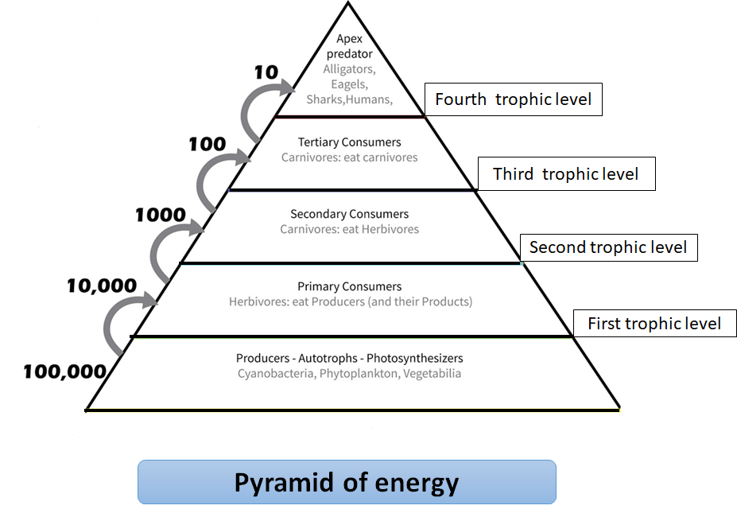
Energy flow models
Single channel energy flow model:
Unidirectional flow of the energy from one trophic level to another
At each trophic level in the food chain energy is lost, and only 10% of energy is transferred to another trophic level this is known as Lindmann’s 10 percent law.
It was given by Raymond Lindemann in 1942 for the lake ecosystem.
The single channel does not involve complex interactions, like nutrient cycling, food webs, etc.

Slide 10
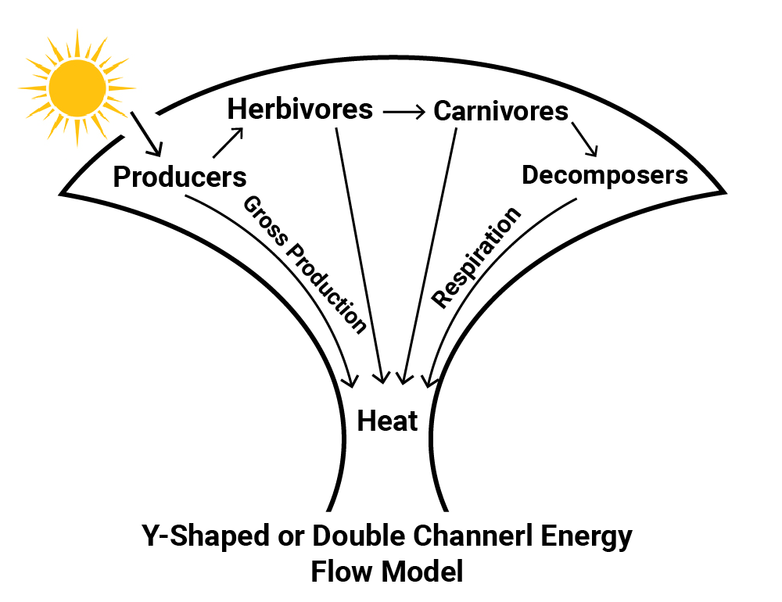
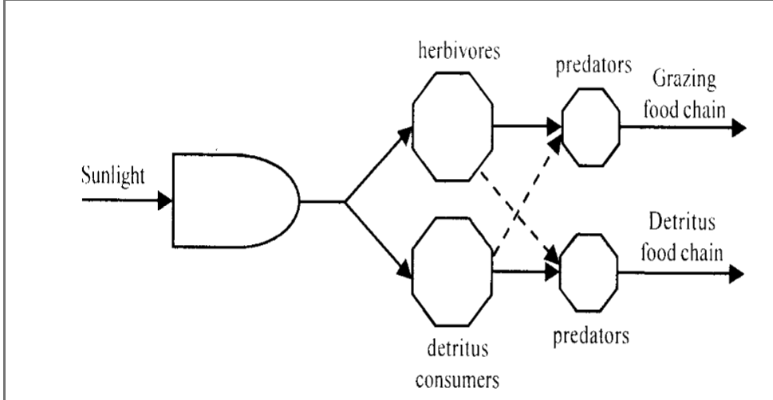
Y-shaped or 2-channel energy flow model
Y-shaped energy flow is more realistic and practical than the single-channel energy flow model.
It confirms the basic stratified structure of ecosystems
It separates the two chains i.e., grazing & and detritus food chain in both time and space.
Micro consumers (bacteria & and fungi) and macro consumers (animals) differ greatly in size-metabolism relations in the two models.

Slide 11
FOOD CHAIN AND FOOD WEB
In the food chain each organism eats the smaller organisms and is eaten by the larger one.
The different levels in a food chain are called tropic levels, each food chain has three main tropic levels:- producer level, consumer level, and decomposer level.
Types of food chains:
a) Grazing food chain: This type of food chain starts from living green plants and goes to grazing herbivores and onto carnivores. ecosystem with such type of food chain directly depends upon the solar energy for their food requirements. most of the ecosystem in nature follows this type of food chain.
b) Detritus food chain: This type of food chain goes from dead organic matter onto microorganisms and then to the organisms feeding on detritus and their predators. Such ecosystems are less dependent on direct solar energy.
c) Parasitic food chain: This type of food chain starts from big hosts and ends with parasitic organisms.
FOOD WEB: The interconnected, interlocking pattern of the food chain is known as the food web.
The food web is an important conceptual tool for illustrating the feeding relationships among species within a community, revealing species interactions and community structure, and understanding the dynamics of energy transfer in an ecosystem.

Slide 13
Succession and Evolution of the Ecosystem
The conversion of a pond to a deciduous forest through various stages such as the development of mesic community, terrestrial community, scrubland and so on or generation and growth of different biospecies in at exposed parent rock are examples of evolution and succession in an ecosystem. So, ecological succession can be defined as a change of community over time, with modification of the physical environment. Ecological succession is a two-step process. First, with the modification of the physical environment one community, mainly autotrophs, tries to survive in the most unfavourable environment, such as an open rock sand dunes, or an aquatic system.
Evolution of a biospecies for the first time in a sterile area is known as primary succession. The firs community is always autotrophic and is usually known as the pioneer community as its evolution occurs in a purely inorganic environment. The continuance of the life cycles of the pioneer community makes the environment rich in organic matter which helps the succession of the second community. As a lot of organic matter is available (sewage bed, organic waste), the secondary succession is mainly heterotrophic.
The succession process continues till a stable community is developed. The transitional series of communities which develop during succession are called seres or seral stages while the stable community that develops finally is called climax community which is mostly a deciduous forest. Series of different physical environments are depicted in Table 3.2.
Table 3.2 Evolution of Biospecies
Physical Environment Biospecies
Aquatic system Hydrach succession or Hydrosere
Exposed parent rock Xosere
Dry sand (Desert) Psammosere
Saline land Halosere

Slide 14
ECOLOGICAL PYRAMIDS
The graphical representation of the trophic levels is called as ecological pyramids.
It was devised by an ecologist “Charles Elton” therefore these pyramid are also called ecological pyramid or Eltonian pyramids.
Types of Ecological Pyramids:
Pyramid of Number
Pyramid of biomass
Pyramid of Energy
Pyramid of Number: They show the relationship between producers, herbivores, and carnivores at successive tropic levels in terms of their number.
In the case of pond ecosystem the producers are mainly phytoplankton and are always maximum in number this number then shows a decrease towards apex as primary consumers are zooplanktons are lesser in number than phytoplankton, the secondary consumers are large fish are even lesser in number than the phytoplankton.
Thus the shape of the pyramid is upright.

Slide 15
In the case of a forest ecosystem the pyramids are always inverted because the producers are mainly large trees, are lesser in numbers, and the herbivores fruit-eating birds are more in number than the producers.
Then there is a gradual decrease in the number of secondary consumers thus making the pyramid upright again.

Slide 16
PYRAMID OF BIOMASS
The pyramid of biomass represents the relationship between different tropic levels in terms of biomass.
There is generally a gradual decrease in the biomass of organisms at successive levels from the producers to the top carnivores.
Thus, the pyramid of biomass is upright for the grassland ecosystem.
However, in the case of a pond as the producers are algae, are the least in number, and this value gradually shows an increase towards the apex of the pyramid thus making the pyramid inverted in shape.

Slide 17
Pyramid of energy
A pyramid of energy is a graphical representation of the amount of energy at each trophic level of a food chain.
They are expressed in units of energy per area per time (e.g., kj m^{–2} year^{–1})
Pyramids of energy will never appear inverted as some of the energy stored in one source is always lost upon transfer.
Each level should be roughly one-tenth of the size of the preceding level (as energy transformations are ~10% efficient)
The bottom level will always represent the producers, with subsequent levels representing consumers (primary, secondary, etc.)

Slide 18

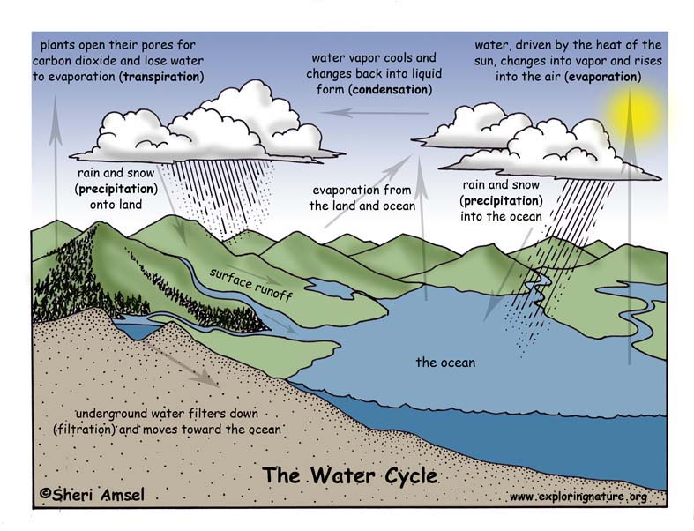
Water cycle

Slide 19
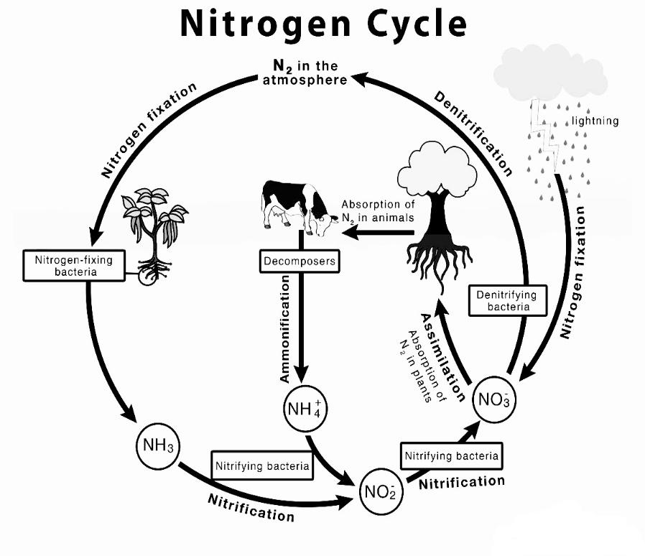
Nitrogen cycle

Slide 20
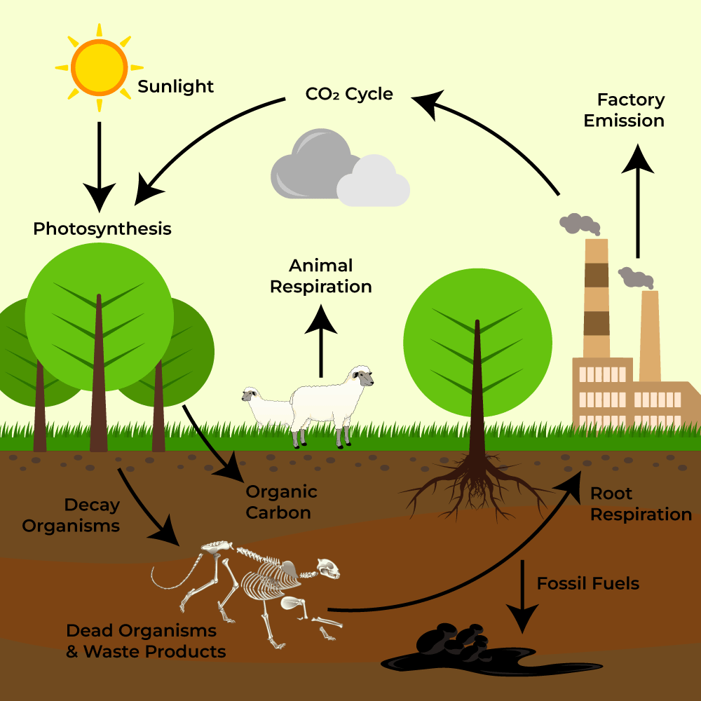
Carbon cycle

Slide 21
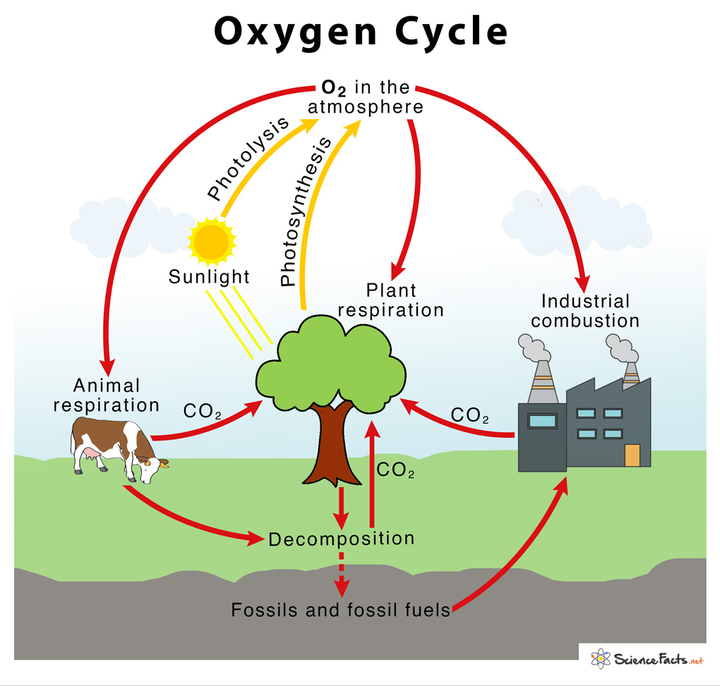
Oxygen cycle

Slide 22
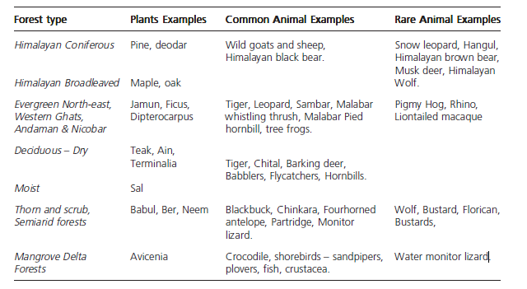
Forest ecosystem
It has 2 components :
Biotic that includes plants and animal communities, types of forests, their products etc.
Abiotic that includes the mountains, river valleys, hills, amount oof rainfall, local temperature, precipitation, humidity etc.

Slide 23
Tropical Rainforests: Located near the equator, these forests are characterized by high temperatures and heavy rainfall throughout the year.
They are incredibly biodiverse, hosting a wide variety of plant and animal species.
Tropical rainforests are often referred to as the "lungs of the earth" due to their significant role in oxygen production.
Temperate Forests: Found in regions with distinct seasons, including North America, Europe, and parts of Asia.
These forests experience four distinct seasons: spring, summer, autumn, and winter.
They are home to diverse tree species, such as oak, maple, and beech.
Boreal Forests (Taiga): Extending across the northern regions of North America, Europe, and Asia, the taiga is the world's largest terrestrial biome.
Characterized by cold winters, short summers, and coniferous trees like spruce, fir, and pine.
Wildlife in the taiga includes bears, wolves, and various migratory birds.

Slide 24
Deciduous Forests: found in areas with moderate rainfall and distinct seasons, including parts of North America, Europe, and Asia.
Dominated by trees that shed their leaves in the fall, such as oak, maple, and hickory.
These forests are known for their vibrant foliage during the autumn months.
Coniferous Forests: typically found in colder, northern regions where temperatures remain low throughout the year.
composed mainly of evergreen trees like pine, spruce, and fir.
Coniferous forests are adapted to survive harsh winter conditions.
Mangrove Forests: These unique coastal ecosystems are characterized by salt-tolerant trees and shrubs.
Found in tropical and subtropical regions, mangroves protect coastlines from erosion and provide vital habitat for numerous aquatic species.
Montane Forests: Located in mountainous regions at higher altitudes, these forests are subject to colder temperatures and lower oxygen levels.
Plant and animal species in montane forests have adapted to the challenging mountain environment.

Slide 25
Dry or desert forests: Found in arid regions with limited rainfall, such as deserts and semi-arid areas.
Plant and animal life in these forests have evolved to thrive in harsh, water-scarce conditions.
Tundra: The tundra biome is characterized by extremely cold temperatures, permafrost, and a short growing season.
Vegetation consists of hardy plants like mosses, lichens, and dwarf shrubs, with limited tree growth.
Tundra ecosystems are home to unique wildlife like reindeer, arctic foxes, and polar bears.
(FUNCTIONS OF FOREST)

Slide 26
GRASSLAND ECOSYSTEM
Grasslands are ecosystems with wide fields of grasses and herbaceous plants and few trees or shrubs.
They are present on all continents except Antarctica and play an important role in global ecosystems and human cultures.
Temperate grasslands and tropical grasslands (sometimes known as savannas) are the two main types of grasslands.
TEMPERATE GRASSLANDS: Located in areas with significant seasonal temperature changes, such as North America's Great Plains, Eurasia's Russian steppes, South America's Pampas, and Australia.
Grasses dominate the vegetation, with only a few trees and bushes present.
These grasslands have chilly winters and scorching summers, and they frequently face droughts and fires.
Large herbivores such as bison, pronghorn, and gazelles, as well as predators and many bird species, live in temperate grasslands.
These ecosystems are also extremely beneficial for agriculture since wheat, maize, and soybeans are widely farmed in these areas.

Slide 27
Savannas (tropical grasslands):
Found in tropical places with year-round mild temperatures, such as Africa, South America, Australia, and portions of Asia.
Savannas are often composed of a patchwork of grasslands and scattered trees or bushes.
These ecosystems have distinct wet and dry seasons, with protracted drought spells throughout the dry season.
Savanna fauna includes huge herbivores such as elephants, giraffes, zebras, and antelopes, as well as predators like as lions, cheetahs, and hyenas.
Savannas are frequently inhabited by nomadic or semi-nomadic human tribes that rely on agriculture.
FUNCTIONS: Grasslands are the grazing areas of many rural communities.
The thorny bushes and branches of the few trees that are seen in grasslands are seen as a major source of fuelwood.
Grasslands have diverse species of insects that pollinate crops.

Slide 28
DESERT ECOSYSTEM
Deserts and semi-arid areas are in western India and the Deccan plateau. the climate in these vast tracts is extremely dry. there are also cold deserts such as in Ladakh, which are located in the high plateaus of the Himalayas.
The most typical desert landscape that is seen in Rajasthan is in the Thar desert.
The great and little Rann of Kutch are highly specialized arid ecosystems.
FUNCTIONS/USES: Scrubland has been used for camel, cattle, and goat grazing in Rajasthan and Gujarat, and for sheep
Grazing in the Deccan plateau.
Areas that have a little moisture, such as along the watercourses, have been used for growing crops such as jowar, and bajra because the natural grasses and local varieties of crops have adapted to growing at very low moisture levels.
These can be used for genetic engineering and developing arid land crops for the future.

Slide 29
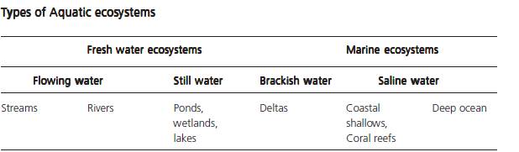
Aquatic ecosystem
Aquatic ecosystems are comprised of plants and animals that live in water.
These species are adapted to live in different types of aquatic habitats.
The special abiotic features are its physical aspects such as the quality of the water, which includes its clarity, salinity, oxygen content, and rate of flow.
Aquatic ecosystems may be classified as being stagnant ecosystems or running water ecosystems.

